Slide 1
Student success project
Brunel university London + Union of Brunel students
Robyn Fitzharris
Mohamed Omar
Iqbal Miah
Notes:
Add logo

Slide 2
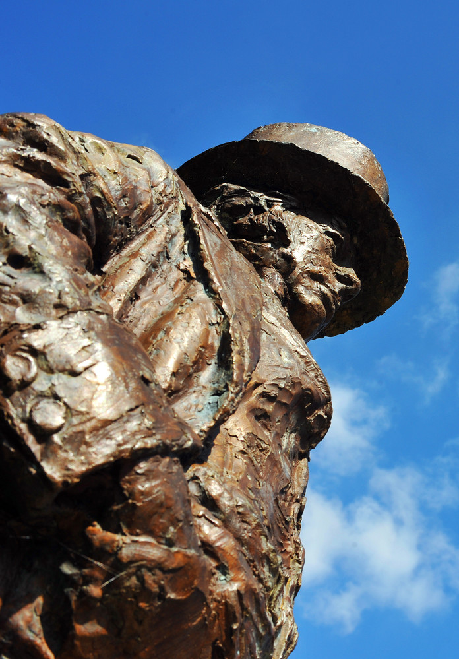
Introduction to brunel
Brunel University London is based in Uxbridge
~14,000 students, 28% EU/International
Ethnicity breakdown:5% Arab, 28% Asian,15% Black, 6% Chinese 9% Other/Mixed, 36% White.
Notes:
Iqbal

Slide 3
About the student success project
Collaboration between Brunel University London and Union of Brunel Students. Funded for three years, started in September 2016, led by Pro-Vice Chancellor (Quality Assurance and Enhancement).
Aiming to close attainment gap between Black students and White students. 22% in 2014/15, 16% in 2016/17.
Four key strands of work, focused on removing barriers to success:
Assessment
Awareness
Curriculum
Support and Sense of Belonging
Notes:
Robyn

Slide 4
About the student success project
Not targeted interventions, avoiding deficit model approach.
Also concerned with attrition.
Working across academic departments and professional service departments.
Particularly those working in Student Success more broadly (Access Agreement).
Notes:
Robyn

Slide 5
Assessment
Assignment Checklist
Assessment audit
Over assessing
Bunching
Integrated Programme Assessment
Notes:
Assignment checklist – Robyn
Assessment audit - Mo

Slide 6
Awareness - Students
Focus Groups
Stalls
Rep Congree Workshop
Brunel Listens

Slide 7
Awareness - Staff
Meetings with Heads of Departments and Directors of Teaching and Learning
Presentations at University events
Academic Staff Network Projects
Committee Papers
Notes:
Robyn

Slide 8
Curriculum
Liberated Library
Theatre and English Curriculum Audit
More departments conducting reviews
Notes:
Mo – Liberated Library first run
Iqbal – Second round + continue

Slide 9
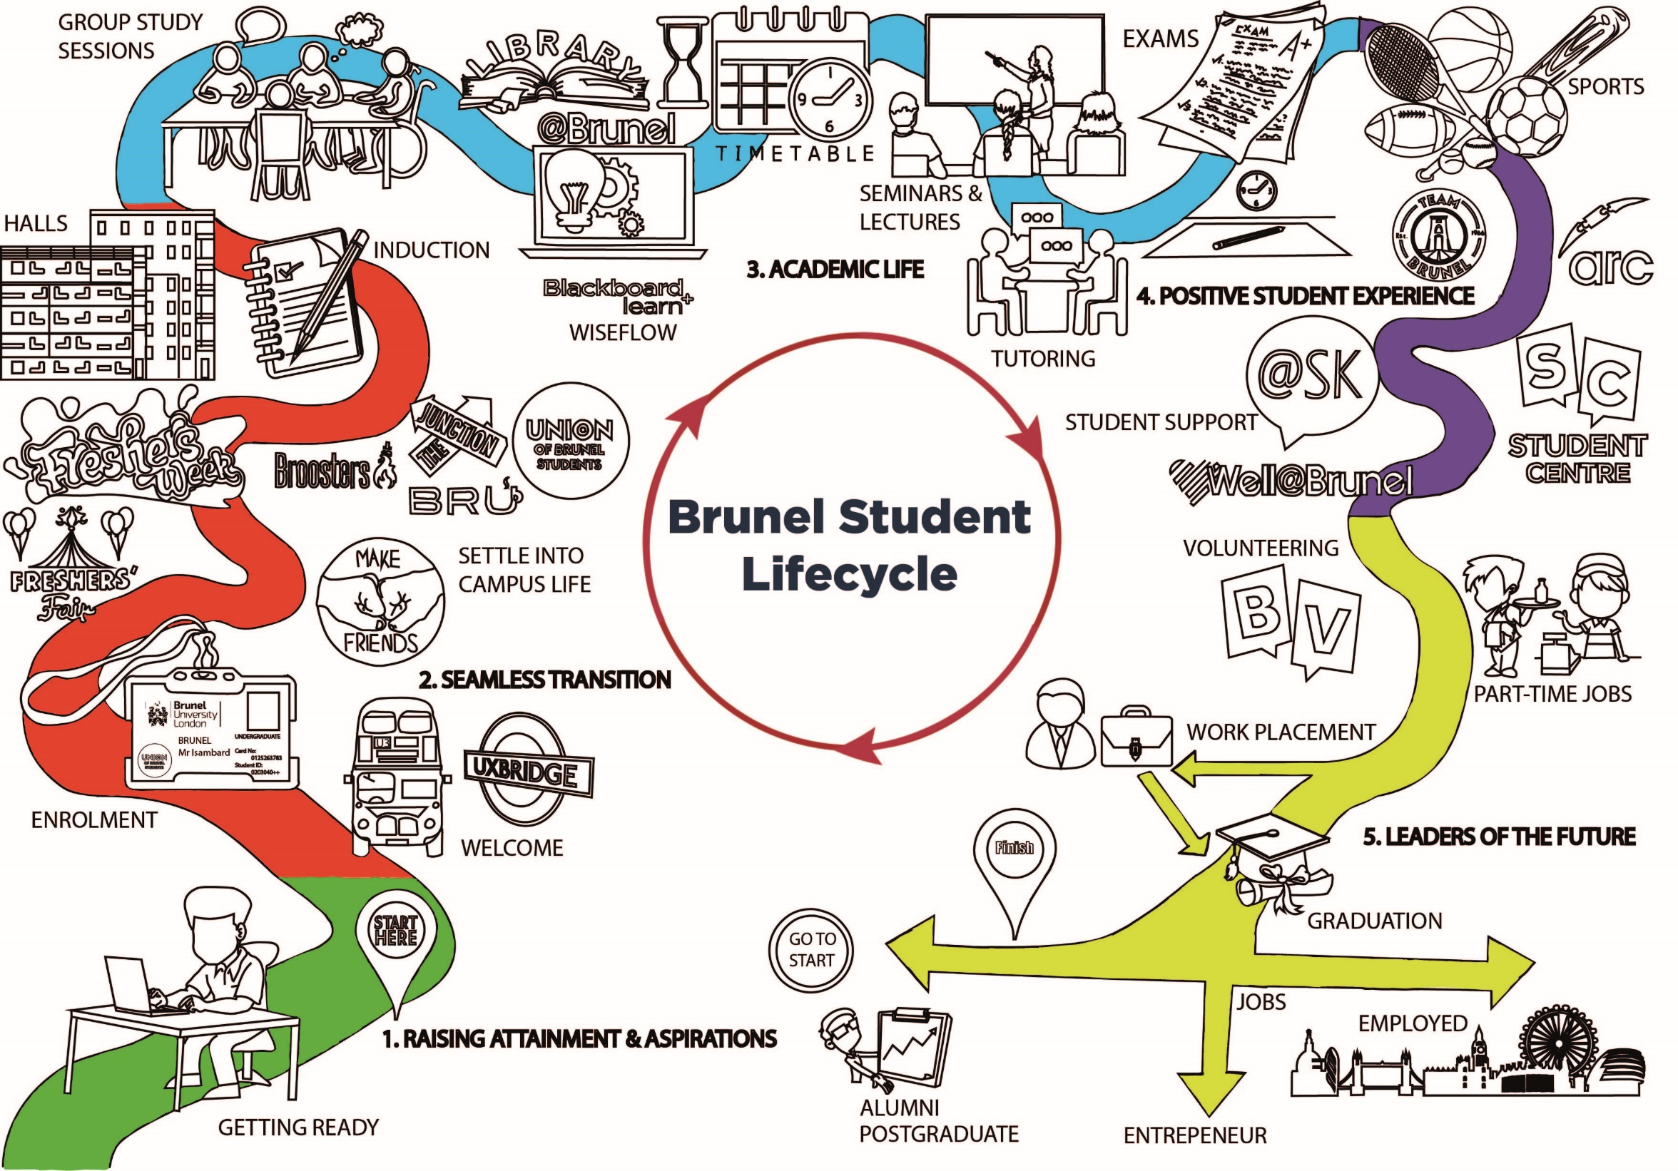
Support and sense of belonging
Student Lifecycle
Friends and Family Guide
Academic Introduction Tasks
Notes:
Robyn

Slide 10
Next steps
Student engagement (expanding Brunel listens)
Rolemodels campaign
Curriculum framework
Game based learning
Review and evaluation
& much more!
Notes:
Mo, student union plans / student engagement
Iqbal, rolemodels
Robyn, curriculum framework, game based learning

Slide 11
summary
Halfway through the project
Collaboration and senior lead is important
Lots of different activities but all ties back to the action plan
Robyn.Fitzharris@brunel.ac.uk
VP.CEDPS@brunel.ac.uk
Follow us on social media: @BrunelSSP

