Slide 1
Enabling Success for WP Learners
Nikki Anghileri
AccessHE
06/02/18

Slide 2
St Mary’s University
Origins as a Catholic teacher training college
University status January 2014
6000 students across 4 Schools
Small and friendly
Over 50% WP
Enduring disparities in retention and success for some populations

Slide 3
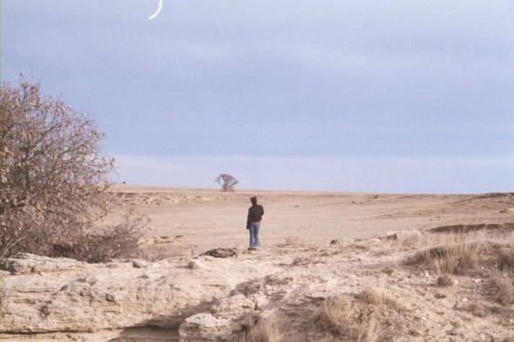
The starting position
“Skills Shop”
1 fte Learning Advisor
Minimal information
But also:
A blank slate
Some great champions
Some big promises

Slide 4
The Current (Evolving) Situation
Learning and Teaching Directorate
Functions include:
Widening Participation Initiatives
Learning Development
Curriculum design and pedagogy
Academic Professional Development
Student Engagement
Personal Tutoring
Access Agreement, TEF
Foundation Year

Slide 5
Principles for Enhancing Student Success?
Driven by research and scholarship
What Works?
Embedded in curriculum
Delivered to all
Informative and relevant, with explicit purpose
Early engagement is essential
All activities should encourage collaboration
Not remedial
Shared responsibility
Moving away from “what is wrong with these students” towards acknowledgement that all students, to a greater or lesser extent, need clarification and sometimes instruction about the expectations and processes of HE level study

Slide 6
What does it look like for us?
Embedded modules
Module-specific workshops
Programme-based tutorials
Targeted interventions
Pre-sessional and in-sessional Transition programmes
Peer mentoring
Financial support

Slide 7
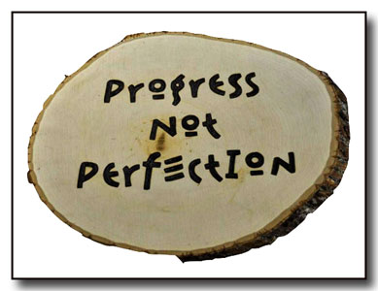
Student Success – No Silver Bullet
WP students are not heterogeneous
Complex issues which need bespoke individualised responses
Valued
Inclusive
Flexible
Programme specific
Quality learning experience
Collaborative – promote peer support (staff and students)
Ongoing process (shifting sands)
Measure impact wherever possible, however possible

Slide 8
Measuring Impact
Satisfaction is not the same as impact
Use whatever measures are available
Student analytics/demographics
Assessment results, progression data, retention data, module evaluations and programme review, survey results (inc NSS)
Qualitative data
Research Projects
Constantly evolving

Slide 9
Student Life Cycle Approach to Success
Access
Success
Progression
Includes: Outreach, Pre-session, Induction, Transition, In-session, Curriculum design, Pedagogy, Assessment, Enhancement, Financial Support, Students’ Realities, Progression
Belonging is key

Slide 10
Ongoing challenges
The hard to reach remain hard to reach!
Capacity – managing expectations
Definitions of success
Traditional models of HE (perceptions/resistance/skills)
Messages
Data
Technology (and technology users)
And much more……
But we’re not giving up just yet!!

Slide 11
Thank-you for listening! Over to you…….
nikki.anghileri@stmarys.ac.uk

